Slide 1

Baldur’s Gate 3
Hasan Denizhan

Slide 2
VERI TABLOSU
recommendationid | language | review | timestamp_created | timestamp_updated | voted_up
153560814 | english | This game hits all the right marks. 10/10 | 1702542971 | 1702542971 | TRUE
153560623 | english | took me like 11 hours to understand the basics | 1702542657 | 1702542657 | TRUE
153560414 | english | 10/10 game play and story! It's my first turn based rpg game, and I have been loving it so far :D | 1702542275 | 1702542275 | TRUE
153560343 | english | gale is so baby girl | 1702542158 | 1702542158 | TRUE

Slide 3
Recommendationid : unique id of the recommendation
Language : user indicated review's language
Review : text of written review
timestamp_created : date the review was created
timestamp_updated : date the review was last updated
voted_up : true means it was a positive recommendation
votes_up : number of users that found this review helpful
votes_funny : number of users that found this review funny
weighted_vote_score : helpfulness score
written_during_early_access : true if the user posted this review while the game was in Early Access
comment_count : number of comments posted on this review
steam_purchase : true if the user purchased the game on Steam
received_for_free : true if the user checked a box saying they got the app for free

Slide 4
Kutuphane eklemek
import pandas as pd import matplotlib.pyplot as plt import nltk from sklearn.model_selection import train_test_split from sklearn.feature_extraction.text import TfidfVectorizer from sklearn.linear_model import LogisticRegression from sklearn.naive_bayes import MultinomialNB from sklearn.ensemble import RandomForestClassifier, GradientBoostingClassifier from sklearn.neighbors import KNeighborsClassifier from sklearn.svm import SVC from sklearn.metrics import accuracy_score, classification_report

Slide 5
from sklearn.preprocessing import StandardScaler from sklearn.pipeline import make_pipeline, Pipeline from sklearn.compose import ColumnTransformer from keras.models import Sequential from keras.layers import Embedding, LSTM, Dense from xgboost import XGBClassifier import timeit from keras.preprocessing.text import Tokenizer from keras.preprocessing.sequence import pad_sequences from sklearn.linear_model import LinearRegression

Slide 6
Kelime ayirmak
def word_freq(data, label, target, text, title):
#Belirli bir etiketle etiketlenmiş verileri içeren bir alt küme oluşturulur.
freq_df = data[data[target] == label]
#Belirli bir sütundaki metin verilerini içeren bir listeyi oluşturur.
freq_words = freq_df[text].dropna().tolist() # Drop NaN values freq_words = [str(i).lower() for i in freq_words] # Convert to string before lowercasing freq_punc = [] # Her bir metni tokenize eder ve noktalama işaretlerinden arındırır. for o in freq_words: freq_punc += nltk.word_tokenize(o) freq_punc = [o for o in freq_punc if o not in string.punctuation]
# Noktalama işaretlerinden arındırılmış kelimelerin frekansını hesaplar. freq_freq = Counter(freq_punc) # En çok kullanılan 50 kelimeyi bulur. freq_top = freq_freq.most_common(50) # Grafik oluşturarak en çok kullanılan kelimelerin frekansını gösterir. words = [word for word, _ in freq_top] counts = [count for _, count in freq_top] plt.figure(figsize=(15, 25)) plt.barh(words, counts) plt.title(title) plt.xlabel("Frequency") plt.ylabel("Words") # En çok kullanılan kelimelerin ve frekanslarının bir listesini döndürür. return freq_top

Slide 7
Kelime gorsellestirmek
def print_wordcloud(dict_top): dict_top = dict(dict_top) word_cloud = WordCloud( width=1200, height=700, background_color="black", min_font_size=5 ).generate_from_frequencies(dict_top) plt.figure() plt.imshow(word_cloud) plt.axis("off") plt.tight_layout(pad=0) plt.show()

Slide 8
start_time = timeit.default_timer() df = pd.read_csv('BG3_reviews.csv') print(df.info()) print(df.isnull().sum()) df_cleaned = df.dropna() print(df_cleaned.isnull().sum())

Slide 9
<class 'pandas.core.frame.DataFrame'>
RangeIndex: 309103 entries, 0 to 309102
Data columns (total 13 columns):
# Column Non-Null Count Dtype
--- ------ -------------- -----
0 recommendationid 309103 non-null int64
1 language 309103 non-null object
2 review 308086 non-null object
3 timestamp_created 309103 non-null int64
4 timestamp_updated 309103 non-null int64
5 voted_up 309103 non-null bool
6 votes_up 309103 non-null int64
7 votes_funny 309103 non-null int64
8 weighted_vote_score 309103 non-null float64
9 written_during_early_access 309103 non-null bool
10 comment_count 309103 non-null int64
11 steam_purchase 309103 non-null bool
12 received_for_free 309103 non-null bool

Slide 10
dtypes: bool(4), float64(1), int64(6), object(2)
memory usage: 22.4+ MB
None
recommendationid 0
language 0
review 1017
timestamp_created 0
timestamp_updated 0
voted_up 0
votes_up 0
votes_funny 0
weighted_vote_score 0
written_during_early_access 0
comment_count 0
steam_purchase 0
received_for_free 0
dtype: int64

Slide 11
recommendationid 0
language 0
review 0
timestamp_created 0
timestamp_updated 0
voted_up 0
votes_up 0
votes_funny 0
weighted_vote_score 0
written_during_early_access 0
comment_count 0
steam_purchase 0
received_for_free 0
dtype: int64

Slide 12
# Visualization value_counts = df_cleaned['voted_up'].value_counts() labels = ['Liked' if x else ‘Disliked' for x in value_counts.index] fig, ax = plt.subplots() pie = ax.pie(value_counts, labels=labels, colors=['green', 'red'], autopct='%1.1f%%', startangle=0, counterclock=False) counts = [f"{count} ({percentage:.1f}%)" for count, percentage in zip(value_counts, value_counts / value_counts.sum() * 100)] ax.legend(pie[0], counts, title="Counts", loc="lower center", bbox_to_anchor=(0.5, -0.15)) plt.show()

Slide 13
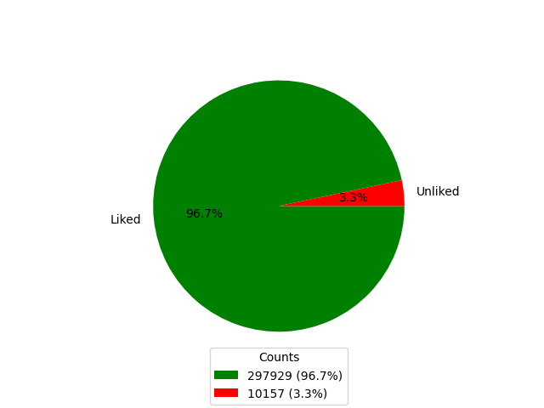
Disliked

Slide 14
DisLiked = word_freq(df, 0, "voted_up", "review", "Most Used 100 Unliked ") Liked = word_freq(df, 1, "voted_up", "review", "Most Used 100 Liked") print_wordcloud(DisLiked) print_wordcloud(Liked) plt.show()

Slide 15
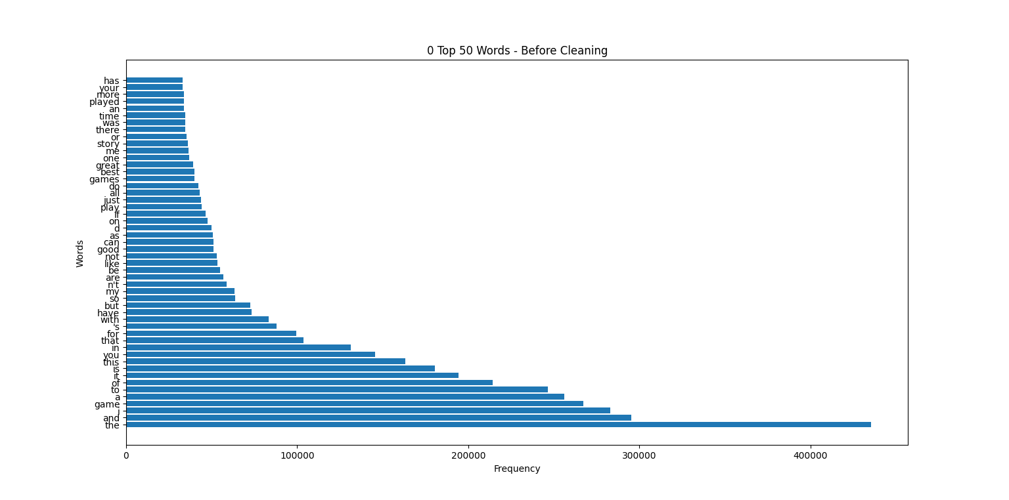
LIKED

Slide 16
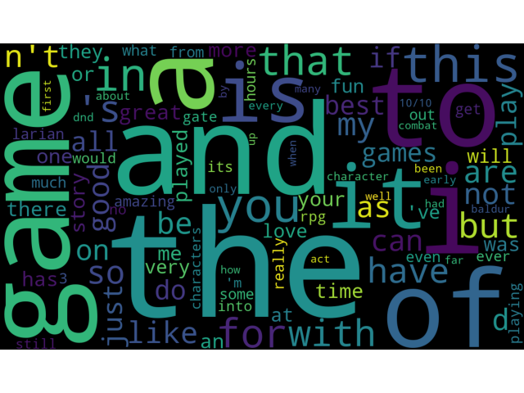

Slide 17
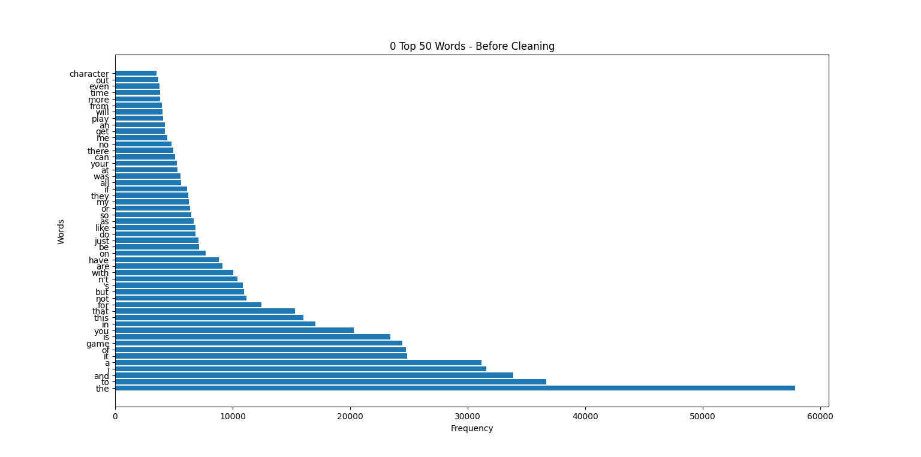
DISLIKED

Slide 18
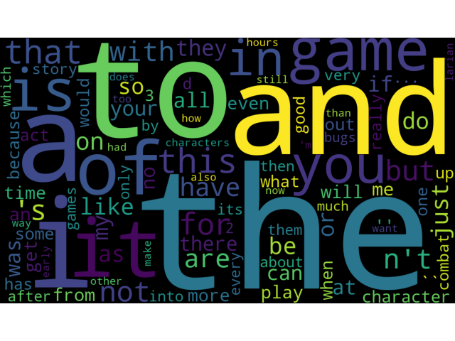

Slide 19
# Feature extraction using TF-IDF tfidf_vectorizer = TfidfVectorizer(max_features=5000, stop_words='english') X = tfidf_vectorizer.fit_transform(df_cleaned['review']) y = df_cleaned['voted_up'] # Train-test split X_train, X_test, y_train, y_test = train_test_split(X, y, test_size=0.2, random_state=42)
TF-IDF(Term Frequency-Inverse Document Frequency): Metin verilerinden ozellikleri cikarilir.
max_features : En yüksek frekansa sahip olan 5000 kelimenin seçileceğini belirtir.
stop_words='english‘:İngilizce dilinde yaygın olarak kullanılan stop kelimelerini (örneğin, "and", "the", "is" gibi) kaldırır

Slide 20
# Define models models = { 'Linear Regression': LinearRegression(), 'Logistic Regression': LogisticRegression(), 'Naive Bayes': MultinomialNB(), 'Random Forest': RandomForestClassifier(n_estimators=100, random_state=42), 'Gradient Boosting': GradientBoostingClassifier(n_estimators=100, random_state=42), 'K-Nearest Neighbors': make_pipeline(ColumnTransformer( transformers=[ ('num', StandardScaler(with_mean=False), slice(0, -1)) # Use with_mean=False for sparse matrices ], remainder='passthrough' ), KNeighborsClassifier(n_neighbors=5)), 'SVM': SVC(), 'XGBoost': XGBClassifier(n_estimators=100, random_state=42) }

Slide 21
def evaluate_model(model, X_train, X_test, y_train, y_test, model_name): model_start_time = timeit.default_timer() model.fit(X_train, y_train) y_pred = model.predict(X_test) y_pred_binary = (y_pred > 0.5).astype(int) accuracy = accuracy_score(y_test, y_pred_binary) report = classification_report(y_test, y_pred_binary) model_end_time = timeit.default_timer() print(f"{model_name} Model Accuracy: {accuracy:.2f}") print(f"Classification Report for {model_name}:\n", report) print(f"{model_name} Model Training and Evaluation Time: {model_end_time - model_start_time:.2f} seconds") print()

Slide 22
# Train and evaluate models for model_name, model in models.items(): evaluate_model(model, X_train, X_test, y_train, y_test, model_name) # LSTM Model max_words = 10000 max_len = 100 tokenizer = nltk.tokenize.RegexpTokenizer(r'\w+') df_cleaned.loc[:, 'tokenized_text'] = df_cleaned['review'].apply(tokenizer.tokenize) tokenizer = Tokenizer(num_words=max_words) tokenizer.fit_on_texts(df_cleaned['review']) X_lstm = tokenizer.texts_to_sequences(df_cleaned['tokenized_text']) X_lstm = pad_sequences(X_lstm, maxlen=max_len) y_lstm = df_cleaned['voted_up'].astype(int)

Slide 23
X_train_lstm, X_test_lstm, y_train_lstm, y_test_lstm = train_test_split(X_lstm, y_lstm, test_size=0.2, random_state=42)
lstm_model = Sequential() lstm_model.add(Embedding(max_words, 128, input_length=max_len)) lstm_model.add(LSTM(100)) lstm_model.add(Dense(1, activation='sigmoid')) lstm_model.compile(optimizer='adam', loss='binary_crossentropy', metrics=['accuracy']) lstm_start_time = timeit.default_timer() lstm_model.fit(X_train_lstm, y_train_lstm, epochs=5, batch_size=32, validation_split=0.2) lstm_end_time = timeit.default_timer()

Slide 24
# Evaluate LSTM model y_pred_lstm_prob = lstm_model.predict(X_test_lstm) y_pred_lstm = (y_pred_lstm_prob > 0.5).astype(int) accuracy_lstm = accuracy_score(y_test_lstm, y_pred_lstm) report_lstm = classification_report(y_test_lstm, y_pred_lstm) print(f"LSTM Model Accuracy: {accuracy_lstm:.2f}") print(f"Classification Report for LSTM:\n", report_lstm) print()

Slide 25
# User input prediction while True: user_input = input("Enter a review: ").strip() if not user_input: print("Invalid input. Please enter a review.") continue user_input_tfidf = tfidf_vectorizer.transform([user_input]) user_input_lstm = pad_sequences(tokenizer.texts_to_sequences([user_input]), maxlen=max_len) for model_name, model in models.items(): prediction = model.predict(user_input_tfidf) print(f"{model_name} Predicted Result: {'Liked' if prediction[0] else 'Unliked'}") # LSTM prediction prediction_lstm_prob = lstm_model.predict(user_input_lstm) prediction_lstm = (prediction_lstm_prob > 0.5).astype(int) print(f"LSTM Predicted Result: {'Liked' if prediction_lstm[0][0] == 1 else 'Unliked'}") # Overall processing time end_time = timeit.default_timer() print(f"Overall Processing Time: {end_time - start_time:.2f} seconds")

Slide 26
Linear Regression Model Accuracy: 0.97
Classification Report for Linear Regression:
precision recall f1-score support
False 0.77 0.26 0.38 1985
True 0.98 1.00 0.99 59633
accuracy 0.97 61618
macro avg 0.87 0.63 0.69 61618
weighted avg 0.97 0.97 0.97 61618
Linear Regression Model Training and Evaluation Time: 4.52 seconds

Slide 27
Logistic Regression Model Accuracy: 0.98
Classification Report for Logistic Regression:
precision recall f1-score support
False 0.77 0.36 0.49 1985
True 0.98 1.00 0.99 59633
accuracy 0.98 61618
macro avg 0.87 0.68 0.74 61618
weighted avg 0.97 0.98 0.97 61618
Logistic Regression Model Training and Evaluation Time: 1.79 seconds

Slide 28
Naive Bayes Model Accuracy: 0.97
Classification Report for Naive Bayes:
precision recall f1-score support
False 0.63 0.19 0.29 1985
True 0.97 1.00 0.98 59633
accuracy 0.97 61618
macro avg 0.80 0.59 0.64 61618
weighted avg 0.96 0.97 0.96 61618
Naive Bayes Model Training and Evaluation Time: 0.09 seconds

Slide 29
Random Forest Model Accuracy: 0.97
Classification Report for Random Forest:
precision recall f1-score support
False 0.63 0.06 0.10 1985
True 0.97 1.00 0.98 59633
accuracy 0.97 61618
macro avg 0.80 0.53 0.54 61618
weighted avg 0.96 0.97 0.96 61618
Random Forest Model Training and Evaluation Time: 830.27 seconds

Slide 30
Gradient Boosting Model Accuracy: 0.97
Classification Report for Gradient Boosting:
precision recall f1-score support
False 0.71 0.15 0.25 1985
True 0.97 1.00 0.99 59633
accuracy 0.97 61618
macro avg 0.84 0.58 0.62 61618
weighted avg 0.96 0.97 0.96 61618
Gradient Boosting Model Training and Evaluation Time: 342.50 seconds

Slide 31
K-Nearest Neighbors Model Accuracy: 0.97
Classification Report for K-Nearest Neighbors:
precision recall f1-score support
False 0.44 0.02 0.05 1985
True 0.97 1.00 0.98 59633
accuracy 0.97 61618
macro avg 0.70 0.51 0.52 61618
weighted avg 0.95 0.97 0.95 61618
K-Nearest Neighbors Model Training and Evaluation Time: 278.77 seconds

Slide 32
SVM Model Accuracy: 0.98
Classification Report for SVM:
precision recall f1-score support
False 0.80 0.35 0.49 1985
True 0.98 1.00 0.99 59633
accuracy 0.98 61618
macro avg 0.89 0.67 0.74 61618
weighted avg 0.97 0.98 0.97 61618
SVM Model Training and Evaluation Time: 2893.74 seconds

Slide 33
XGBoost Model Accuracy: 0.97
Classification Report for XGBoost:
precision recall f1-score support
False 0.72 0.27 0.40 1985
True 0.98 1.00 0.99 59633
accuracy 0.97 61618
macro avg 0.85 0.64 0.69 61618
weighted avg 0.97 0.97 0.97 61618
XGBoost Model Training and Evaluation Time: 27.56 seconds

Slide 34
6162/6162 [==============================] - 236s 38ms/step - loss: 0.0897 - accuracy: 0.9704 - val_loss: 0.0719 - val_accuracy: 0.9751
Epoch 2/5
6162/6162 [==============================] - 231s 38ms/step - loss: 0.0593 - accuracy: 0.9786 - val_loss: 0.0703 - val_accuracy: 0.9760
Epoch 3/5
6162/6162 [==============================] - 232s 38ms/step - loss: 0.0479 - accuracy: 0.9828 - val_loss: 0.0723 - val_accuracy: 0.9767
Epoch 4/5
6162/6162 [==============================] - 228s 37ms/step - loss: 0.0382 - accuracy: 0.9865 - val_loss: 0.0801 - val_accuracy: 0.9753
Epoch 5/5
6162/6162 [==============================] - 229s 37ms/step - loss: 0.0305 - accuracy: 0.9898 - val_loss: 0.0872 - val_accuracy: 0.9747
1926/1926 [==============================] - 22s 11ms/step

Slide 35
LSTM Model Accuracy: 0.98
Classification Report for LSTM:
precision recall f1-score support
0 0.70 0.45 0.55 1985
1 0.98 0.99 0.99 59633
accuracy 0.98 61618
macro avg 0.84 0.72 0.77 61618
weighted avg 0.97 0.98 0.97 61618

Slide 36
Linear Regression Model Accuracy: 0.97
Logistic Regression Model Accuracy: 0.98
Naive Bayes Model Accuracy: 0.97
Random Forest Model Accuracy: 0.97
Gradient Boosting Model Accuracy: 0.97
K-Nearest Neighbors Model Accuracy: 0.97
SVM Model Accuracy: 0.98
XGBoost Model Accuracy: 0.97
LSTM Model Accuracy: 0.9898
1 | 2 | 3 | 4 | 5 | 6 | 7 | 8 | 9
LSTM | SVM | LOR | LR | NB | RF | GB | KNN | XGB
0.9898 | 0.98 | 0.98 | 0.97 | 0.97 | 0.97 | 0.97 | 0.97 | 0.97

Slide 37
Enter a review: 10/10 game play and story! It's my first turn based rpg game, and I have been loving it so far
Linear Regression Predicted Result: Liked
Logistic Regression Predicted Result: Liked
Naive Bayes Predicted Result: Liked
Random Forest Predicted Result: Liked
Gradient Boosting Predicted Result: Liked
K-Nearest Neighbors Predicted Result: Liked
SVM Predicted Result: Liked
XGBoost Predicted Result: Liked
1/1 [==============================] - 0s 35ms/step
LSTM Predicted Result: Liked
Overall Processing Time: 5741.60 seconds
TOPLAM SURE = 96 DAKIKA

